Slide 1
Hartree-Fock theory, Self-consistent field (SCF)
Instructor: Prof. Tzuhsiung (Nick) Yang
Email: tyang@mx.nthu.edu.tw
Time: M5/6
Room: NTHU Library Comp Lab II
Notes:
Rafael Gomez

Slide 2
Suggested reading
Chapter 2 and 3 in Szabo, A.; Ostlund, N. S. Modern Quantum Chemistry: Introduction to Advanced Electronic Structure Theory; Courier Corporation, 2012.

Slide 3
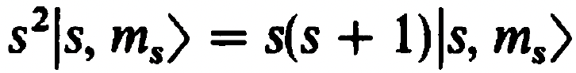
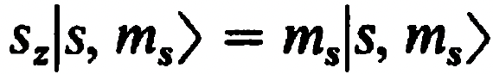
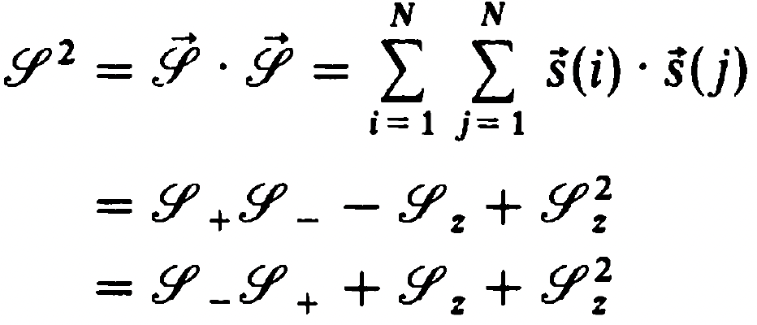
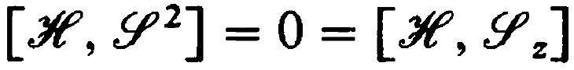
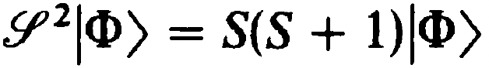
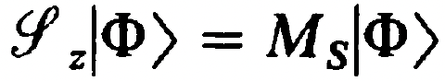
Spin-adapted Configurations
Let’s consider the spin angular momentum operators
,
The total squared magnitude of the spin is
Since the Hamiltonian commutes with ${\hat{S}}_{z}$ and ${\hat{S}}^{2}$
The exact wave function is an eigenfunction of ${\hat{S}}_{z}$ and ${\hat{S}}^{2}$
,
Hence, the eigenvalue of the ${\hat{S}}_{z}$ of the exact wave function is

Slide 4
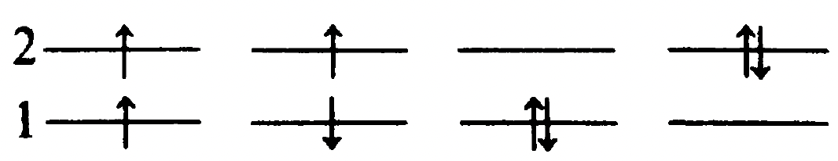
Spin-adapted Configurations
There are three types of determinants:
Close-shell (Restricted) determinants
Open-shell restricted determinants
Open-shell unrestricted determinants
Let’s consider the case of two-electron in four spin orbitals, such as Hartree Fock wave function with minimal basis H₂
There are $\left({4 \atop 2}\right)=6$ configurations
(a)
(b)
(c)
(d)
(e)
(f)
The case (a) is the Hartree Fock ground state wave function in the minimal basis H₂, which is a close-shell determinant.

Slide 5
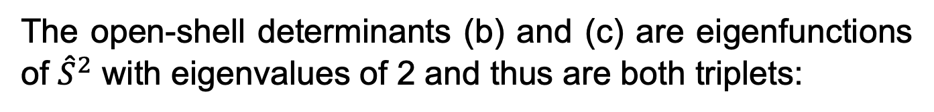
Spin-adapted Configurations
(a)
(b)
(c)
(d)
(e)
(f)
The cases (b)-(e) are four singly excited determinants
The open-shell determinants (b) and (c) are eigenfunctions of ${\hat{S}}^{2}$ with eigenvalues of 2 and thus are both triplets:

Slide 6
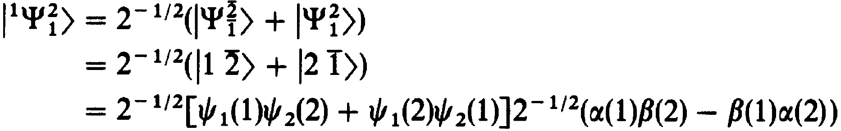
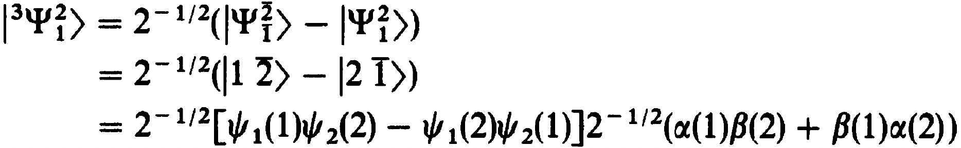
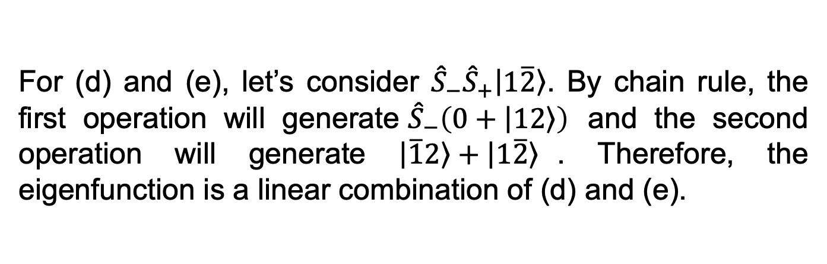
Spin-adapted Configurations
(a)
(b)
(c)
(d)
(e)
(f)
For (d) and (e), let’s consider ${\hat{S}}_{−}{\hat{S}}_{+}\left|\left.1\overline{2}\right\rangle \right.$. By chain rule, the first operation will generate${\hat{S}}_{−}\left(0+\left|\left.12\right\rangle \right.\right)$ and the second operation will generate $\left|\left.\overline{1}2\right\rangle \right.+\left|\left.1\overline{2}\right\rangle \right.$. Therefore, the eigenfunction is a linear combination of (d) and (e).

Slide 7
Spin-adapted Configurations
(a)
(b)
(c)
(d)
(e)
(f)
Thus, the difference between an electronic configuration and a determinant is that a configuration can be multi-determinant.

Slide 8
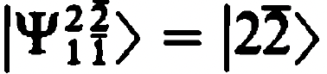
Spin-adapted Configurations
(a)
(b)
(c)
(d)
(e)
(f)
The determinant (f) is just another close-shell determinant that represents the doubly excited wavefunction of the Hartree Fock ground state wavefunction of minimal basis H₂.

Slide 9
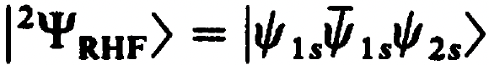
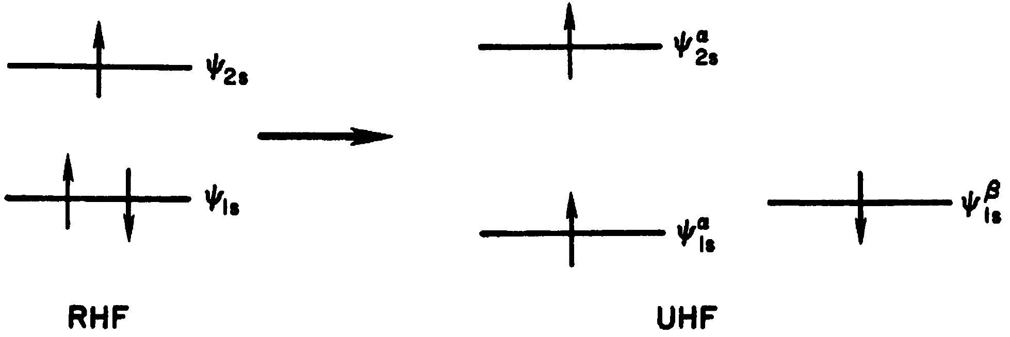
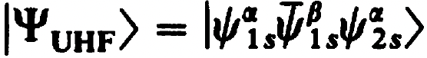
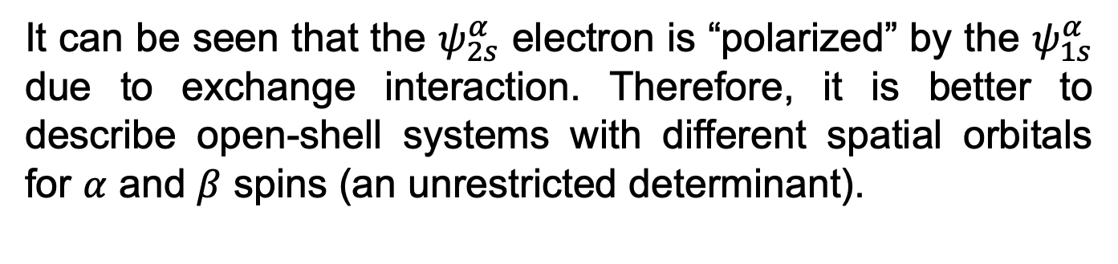

Unrestricted determinants
Let’s consider the ground state wavefunction of Li
It can be seen that the $ψ_{2s}^{α}$ electron is “polarized” by the $ψ_{1s}^{α}$ due to exchange interaction. Therefore, it is better to describe open-shell systems with different spatial orbitals for $α$ and $β$ spins (an unrestricted determinant).
$$⇒$$

Slide 10

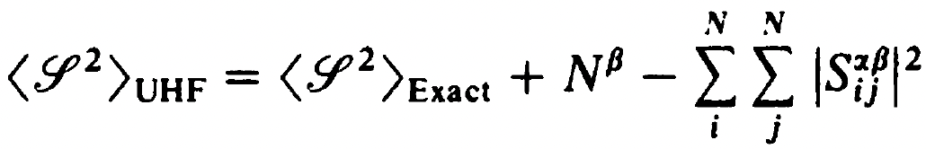
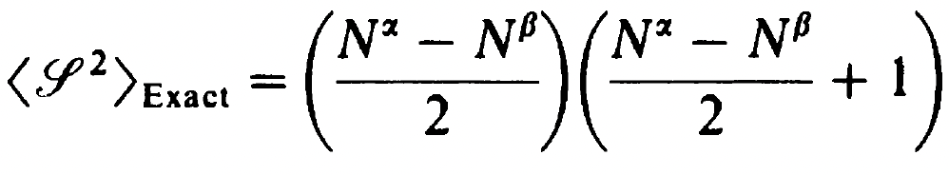
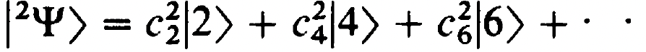
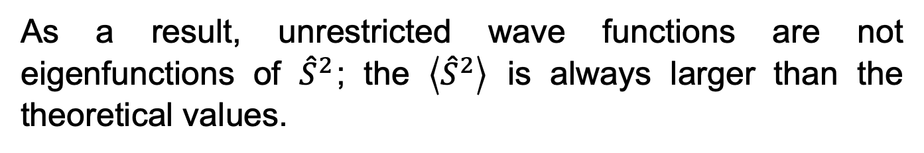
Unrestricted determinants
Unrestricted determinants are formed from spatial orbitals that are not necessarily orthogonal
As a result, unrestricted wave functions are not eigenfunctions of ${\hat{S}}^{2}$; the $\left\langle {\hat{S}}^{2}\right\rangle$ is always larger than the theoretical values.
This is because unrestricted determinants can be expanded as a superposition of the corresponding spin-pure state and the higher spin-pure states. For example,

Slide 11
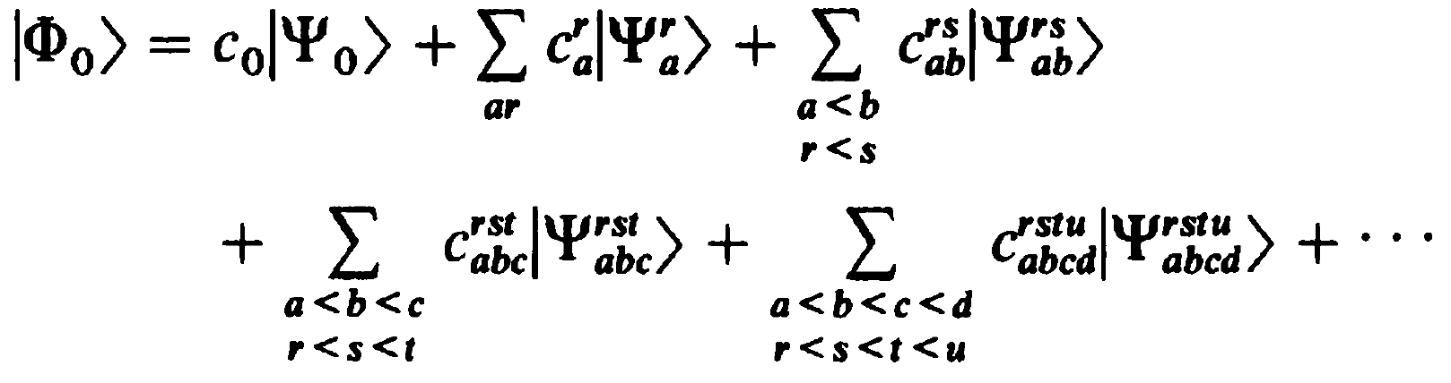
SDs complete set
The exact many electron wavefunction can be expanded using the RHF/ROHF determinant and N-tuply excited determinants.
This expansion ensures that the many-electron wavefunction is an eigenfunction of both the Hamiltonian and the spin angular momentum operator and explicitly treats both the dynamic and static correlations. We will come back to this when we talk about post-HF methods

Slide 12
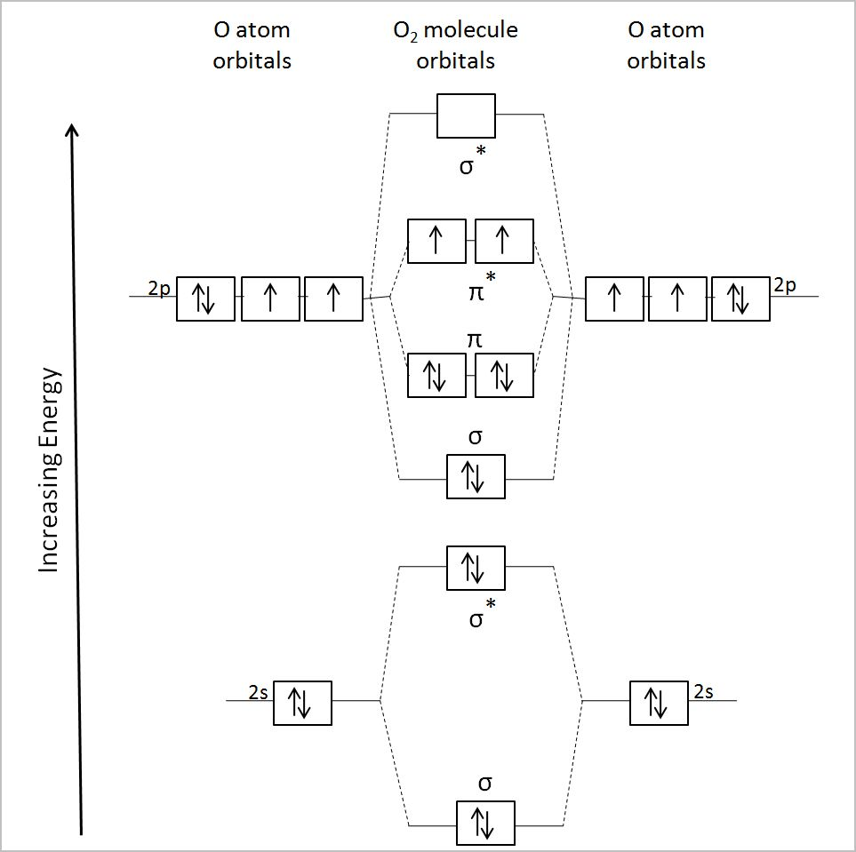
Interactive
Navigate to CompChem/Practice/Week2/Exercise1
Open mcscf.ipynb
Run the cells

Slide 13
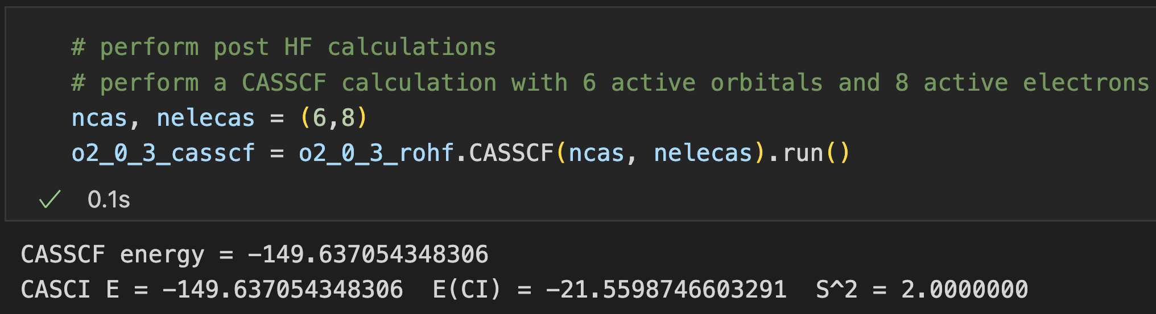
Interactive
Navigate to CompChem/Practice/Week2/Exercise1
Open mcscf.ipynb
Run the cells

Slide 14
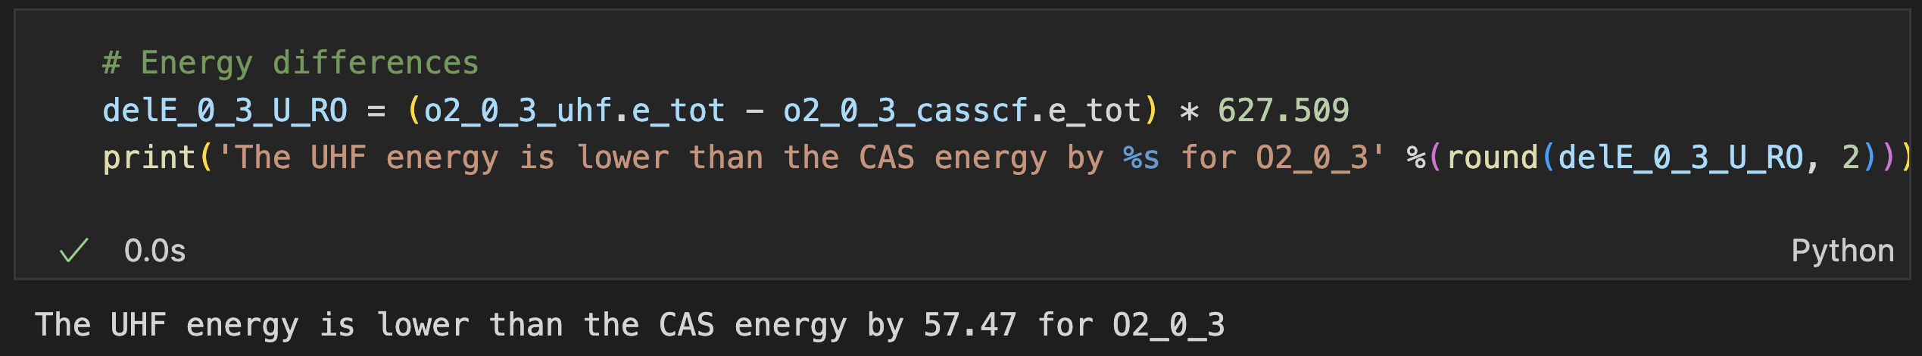
Interactive

Slide 15
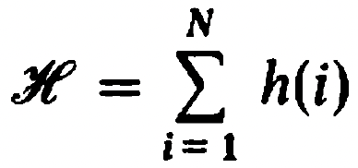
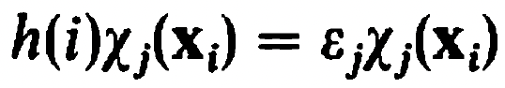

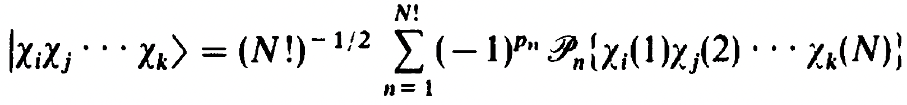
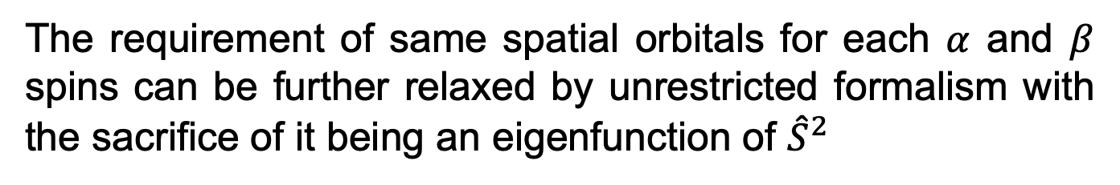
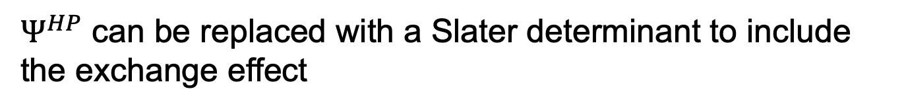
Fock operator
Let’s recall the assumption of Hartree product
,
,
$Ψ^{HP}$ can be replaced with a Slater determinant to include the exchange effect
The requirement of same spatial orbitals for each $α$ and $β$ spins can be further relaxed by unrestricted formalism with the sacrifice of it being an eigenfunction of ${\hat{S}}^{2}$
The important constraint is that the Hamiltonian acts on N non-interacting electrons or N-electrons within a mean-field.

Slide 16
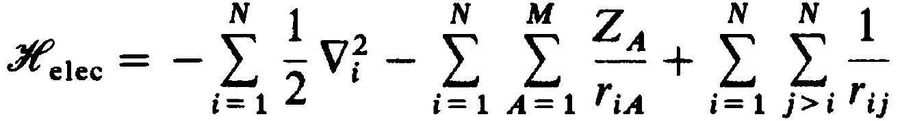
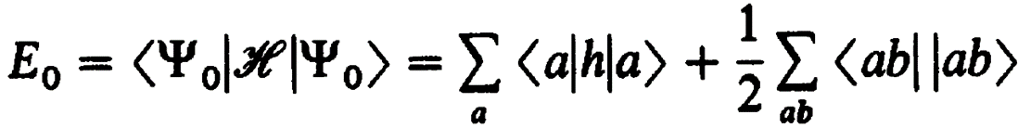
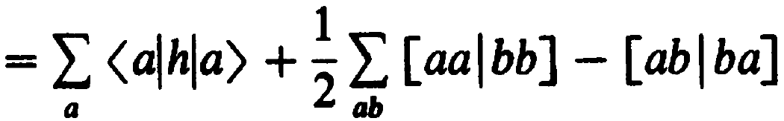
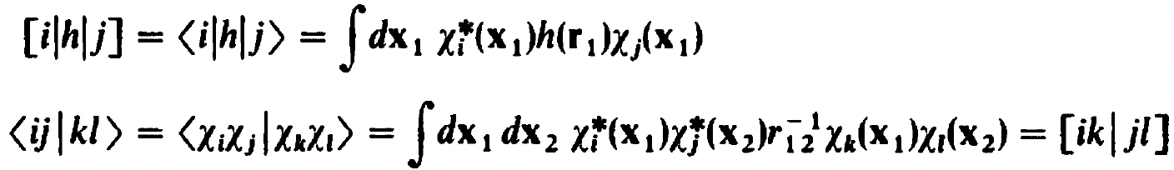
Fock operator
Recall the electronic Hamiltonian
The expectation value of the energy using a SD is then
where < | > and [ | ] mean

Slide 17
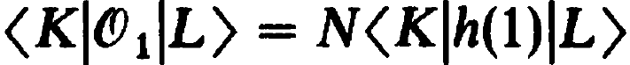
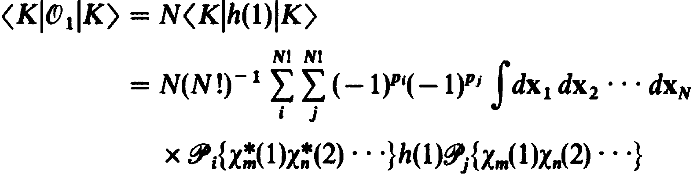
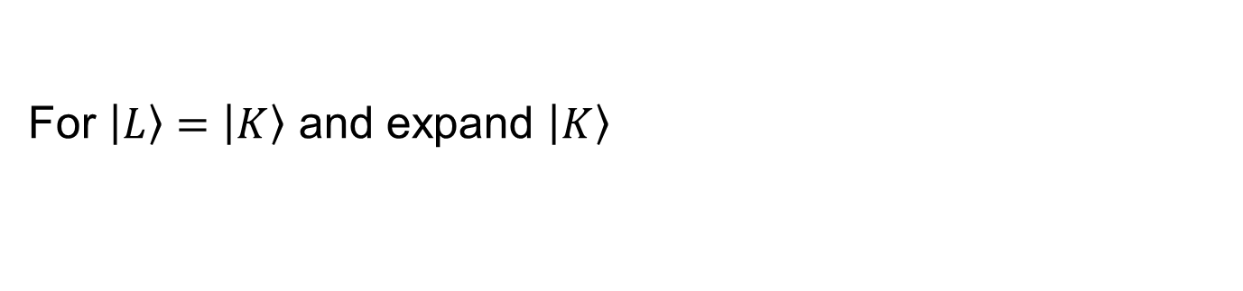
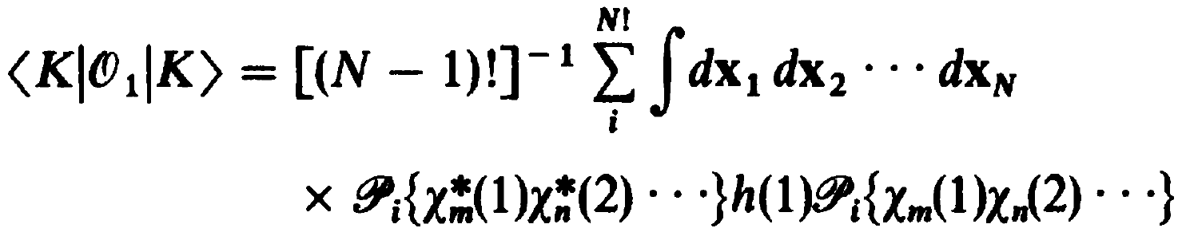
Fock operator
The one electron integral can be derived as below
Since electrons are indistinguishable,
For $\left|\left.L\right\rangle \right.=\left|\left.K\right\rangle \right.$ and expand $\left|\left.K\right\rangle \right.$
Due to $δ_{ij}$, i must equal to j

Slide 18
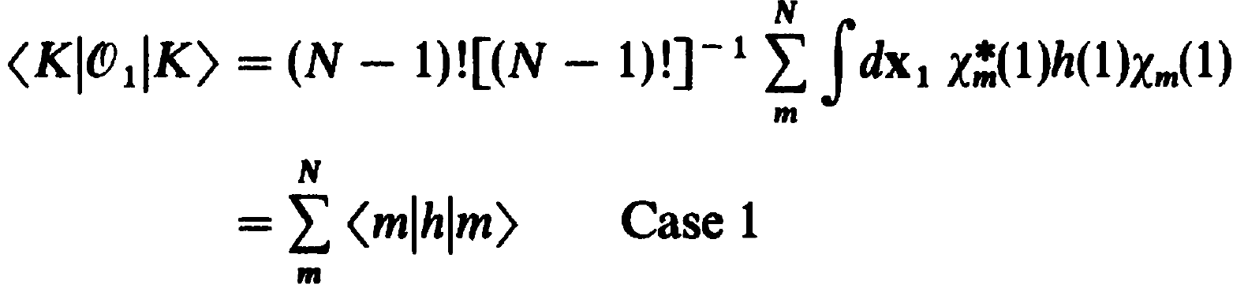
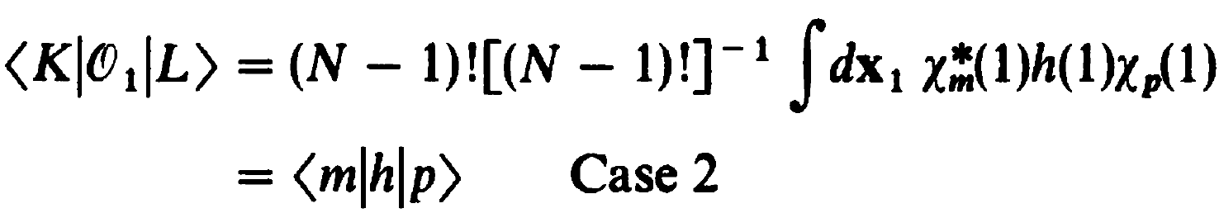
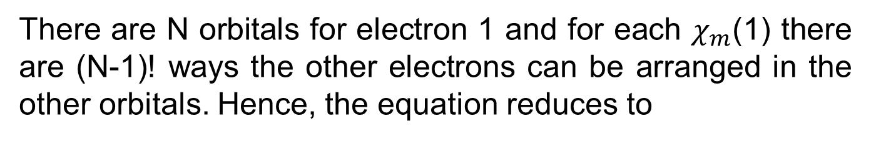
Fock operator
There are N orbitals for electron 1 and for each $χ_{m}$(1) there are (N-1)! ways the other electrons can be arranged in the other orbitals. Hence, the equation reduces to
If the two SDs differ by one orbital, the operator must be associated with the differing orbital in order for the integral to be non-zero (notice the absence of sum over m)

Slide 19
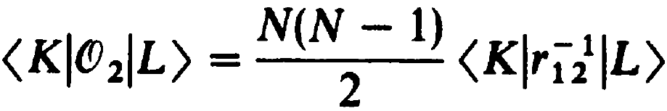
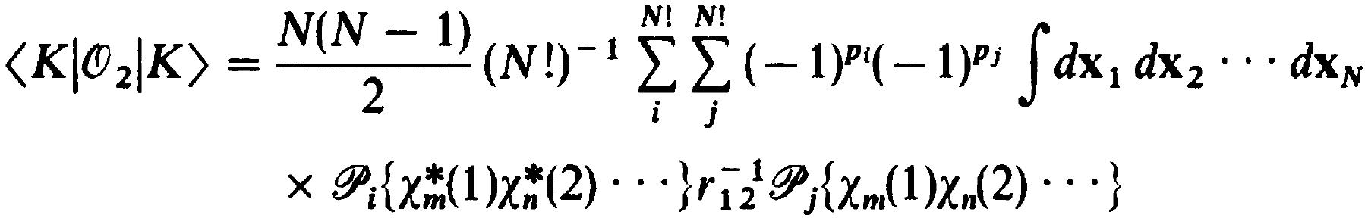
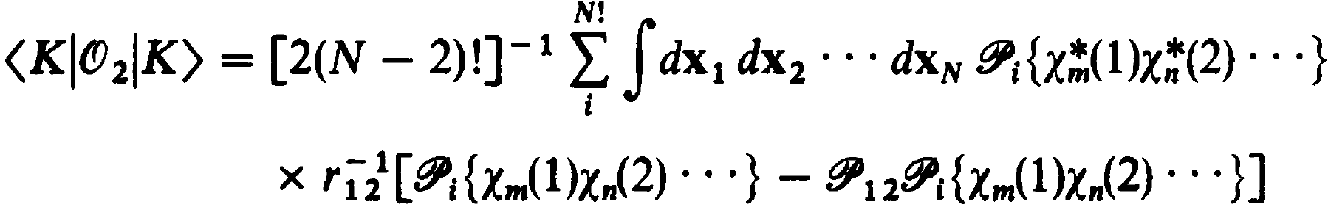
Fock operator
For the two-electron integral,
Likewise, electrons are indistinguishable so
For $\left|\left.L\right\rangle \right.=\left|\left.K\right\rangle \right.$ and expand $\left|\left.K\right\rangle \right.$
All the permutations of i and j must equal for electron 3, 4, …, N and can be exchanged between 1 and 2,

Slide 20
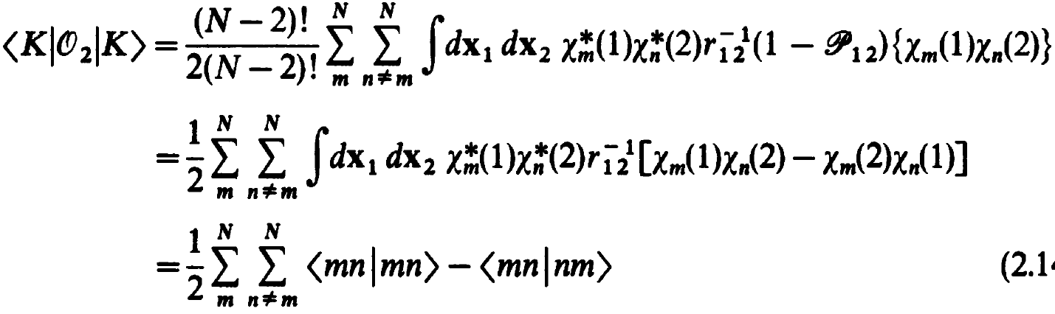
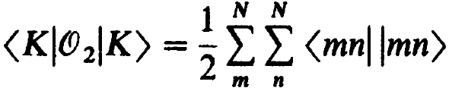
Fock operator
For each electron 1 and 2 occupying N orbitals and N-1 orbitals, respectively, there are (N-2)! ways to arrange electron 3, 4,.., N,
Since equals 0 when m = n

Slide 21
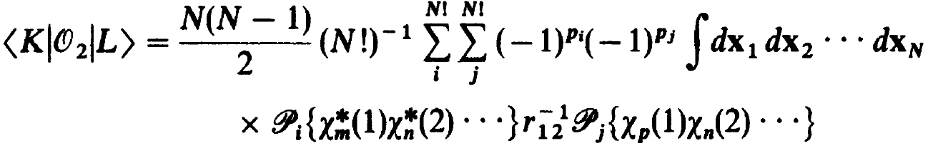
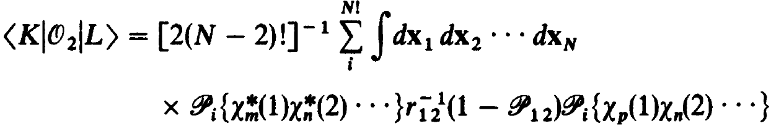
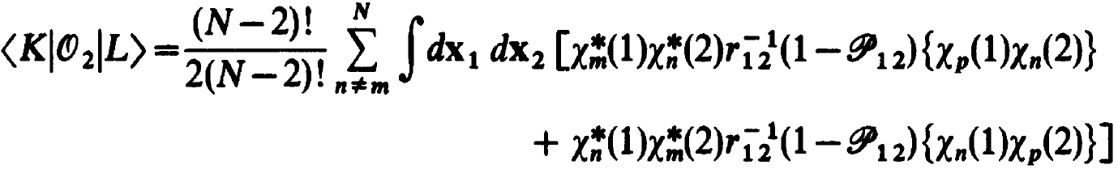
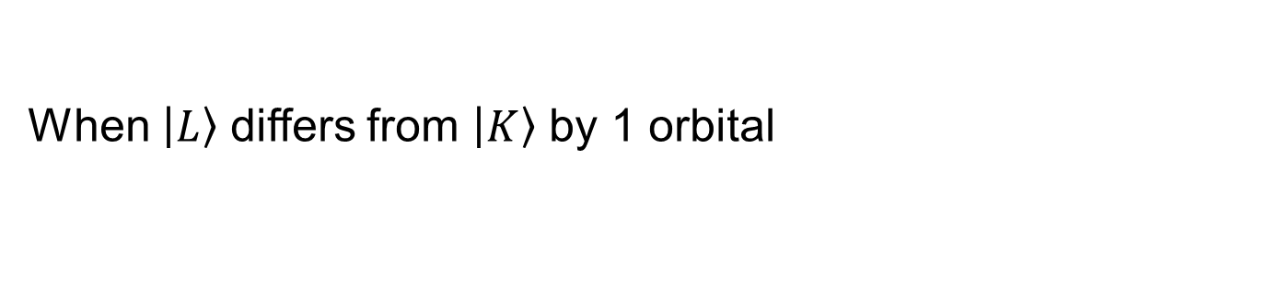
Fock operator
When $\left|\left.L\right\rangle \right.$ differs from $\left|\left.K\right\rangle \right.$ by 1 orbital
All the permutations of i and j must equal for electron 3, 4, …, N and can be exchanged between 1 and 2,
Similar to the case for , the differing orbital must be occupied by electron 1 or 2

Slide 22
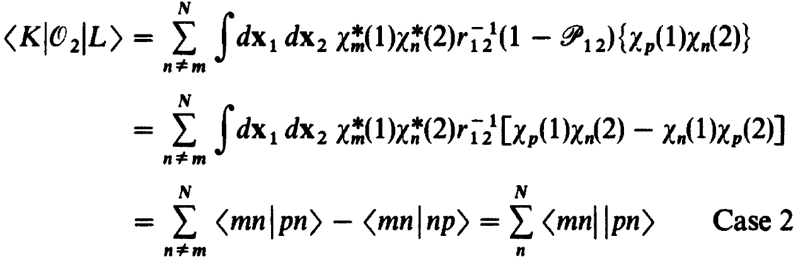


Fock operator
Because the two integrands are equal, we can arrive at
When $\left|\left.L\right\rangle \right.$ differs from $\left|\left.K\right\rangle \right.$ by 2 orbitals

Slide 23
Fock operator
Recall the electronic Hamiltonian
The expectation value of the energy using a SD is then
where < | > and [ | ] mean

Slide 24




Fock operator
In order for the Hamiltonian to act on N-electrons within a mean-field, the two-electron integrals are replaced with mean-field integrals (operators).
$$⇒$$
$$⇒$$
The first term ${\hat{J}}_{b}\left(1\right)$ is a local operator that describes the total averaged potential acting on $χ_{a}(1)$.
The second term ${\hat{K}}_{b}\left(1\right)$ is a non-local operator that describes the total averaged potential, formed by other electrons if they were smeared in the space of $χ_{b}^{∗}χ_{a}$, acting on electron one if it was in spin orbital $χ_{b}$.

Slide 25



Fock operator
With the mean-field approximation, we can write down the (pseudo)eigenvalue problem which gives orbital energies
The operator (Fock operator) can be further written as
because
This last equation that the coulomb and exchange interactions cancel each other out exactly at the one-electron limit may seem trivial. However, it is a very important physical constraint and it is one of the main errors in density functional theory (DFT) called self-interaction error.

Slide 26
Interactive
To show that the two electron coulombic interaction (J_{a}(1)) and the exchange interaction (K_{a}(1)) cancel each other at the one electron limit as a result of the Slater determinant, we will investigate the simplest case, H, using the minimal basis (STO-3G, to be discussed) and UHF with HF equation or UKS (KS = Kohn Sham orbitals, to be discussed) with the PBE functional.
We know the exact solution to the SE for H, which is -0.5 Eh. Run the jupyter notebook in Exercise4 and see which method yields a better solution and why?

Slide 27

Interactive
Navigate to CompChem/Practice/Week2/Exercise2
Open self-interaction-error.ipynb
Run the cells

Slide 28


Slide 29
Interactive
UHF
J_{11,a} is 0.77 Eh
K_{11,a} is 0.77 Eh
Self-interaction error is J_{11,a} - K_{11,a} = 0.000 Eh
UKS(PBE)
J_{11,a} is 0.3873 Eh
E_{xc} is -0.3851 Eh
Self-interaction error is J - E_{xc} = 0.0022 Eh

Slide 30





Hartree Fock theory
The sum of the eigenvalues from the Fock operator is
which is not the energy of the system
$$⇒$$
Because we double count 2e integrals
Let’s consider a closed-shell Slater determinant
The corresponding HF equation is

Slide 31




Hartree Fock theory
Multiplying on the left by $α^{∗}\left(w_{1}\right)$ and integrating over spin
Expand the integrand by the definition of the Fock operator
The coulomb and exchange operators can be combined using the permutation operator, ${\hat{P}}_{12}$
The mean-field, , sums over all other electrons c, each smears in the phase space $d{\overset{⃑}{x}}_{2}$. The phase space contains both the spatial ($dr_{2}$) and the spin ($dw_{2}$) parts.

Slide 32


Hartree Fock theory
Expand and group the 2e integrals by spin coordinates
Thus there is only half as much exchange interaction

Slide 33




Hartree Fock theory
The close-shell Fock operator that considers spin orthonormality is thus
$$≡$$
And the corresponding energy of the system is
where means integrate over spatial orbitals.

Slide 34



Hartree Fock theory
Let’s consider the HF energy of minimal basis H₂
Intuitively, two electrons each with kinetic energy and nuclear attraction energy $h_{11}$ plus one coulombic repulsion energy $J_{11}$.
By the HF equation,
$$E_{0}=2\sum_{a=1}^{1}{h_{aa}}+\sum_{a=1}^{1}{\sum_{b=1}^{1}{{2J}_{ab}−K_{ab}}}=2h_{11}+2J_{11}−K_{11}=2h_{11}+J_{11} ∵J_{11}=K_{11}$$

Slide 35



Hartree Fock theory
Let’s consider the HF orbital energy of minimal basis H₂
When we evaluate the orbital energies, we only need to consider it’s kinetic energy and nuclear attraction energy $h_{11}$ and a coulomb interaction $J_{11}$

Slide 36

Interactive
Navigate to CompChem/Practice/Week2/Exercise3
Open orbital_energy_total_energy.ipynb
Run the cells

Slide 37

Interactive
Notice that h(1) and nuclear repulsion energy were already defined before we even ran the SCF.

Slide 38

Interactive
H, J, F are calculated by multiplying the respective Hamiltonian matrix elements by C^{T} from the left and C from the right.

Slide 39

Interactive
MO energies are simple sum of H1e and V (2J –K)

Slide 40

Interactive
Total electronic energy is sum of h_{a} + sum of e_{orb}

Slide 41

Interactive
Total energy is total electronic energy + nuclear repulsion energy

Slide 42





Koopman’s theorem
So we just showed that the sum of the eigenvalues from the Fock operator is not the total energy of the system because it double counts the two-electron integrals. Why do we bother with the orbital energies then?
Let’s consider the Slater determinant with one electron removed under a frozen orbital approximation
, ${\hat{a}}_{c}$ is the annihilation operator
The corresponding ionization potential is

Slide 43


Koopman’s theorem
, ${\hat{a}}_{c}$ is the annihilation operator

Slide 44





Koopman’s theorem
Similar result holds for electron affinity

Slide 45

Koopman’s theorem
Issues with Koopman’s theorem
The $\left.\left|{}_{}^{N−1}{Ψ_{0}}\right.\right\rangle$ and $\left.\left|{}_{}^{N+1}{Ψ_{0}}\right.\right\rangle$ determinants are not the optimal wave functions. Hence, relaxing the determinants will lead to lower energies.
Because the HF energy neglects electron correlation, which will further lower the energy of the system and is larger in systems with more electrons, IP calculated from Koopman’s theorem will usually produce reasonable agreement with the expected value due to error cancellation from correlation and frozen-orbital effects.
On the other hand, EA values are usually not reasonable due to the compounded errors from correlation and frozen-orbital effects. In fact, HF virtual orbitals have positive energies and will always result in negative EA values.

Slide 46




Brillouin’s theorem
The Hamiltonian matrix element between the ground and the first excited state determinants is
The matrix elements of the Fock operator are given by
The Hamiltonian matrix elements are thus the off-diagonal elements of the Fock operator
which are zero for the ground state HF wavefunction
Note is not zero so the effect of enter the ground state through

Slide 47
Interactive
Navigate to CompChem/Practice/Week2/Exercise4
Open koopman_brillouin.ipynb
Run the cells

Slide 48

Interactive
Koopman’s theorem works ok for IP. Notice the failure of vertical IP from HF for CO, which is caused by the extensive spin contamination.

Slide 49


Interactive
Off-diagonal elements of the Fock matrix are zero. These elements are equivalent to the Hamiltonian matrix elements between the ground state wavefunction $\left|\left.Ψ_{0}\right\rangle \right.$ and the singly excited wavefunctions $\left|\left.Ψ_{a}^{r}\right\rangle \right.$

Slide 50






Roothaan equation
How do we find $ψ_{i}$: linear combination of basis functions (atomic orbitals)
Multiply from the right by $φ_{μ}^{∗}(1)$ and integrate
The integrals on the right form the overlap matrix;
The integrals on the left form the Fock matrix

Slide 51



Roothaan equation
The Roothaan equation in a compact matrix form is thus
The expansion coefficients (MO coefficients) are
Molecular orbitals $ψ_{i}$ are formed by multiplying the basis functions $\left.\left|φ_{u}\right.\right\rangle$ to the left of C

Slide 52


Self-consistent field
Charge density, which sums to N, is determined as
Density matrix for closed-shell is thus defined as

Slide 53


Self-consistent field
Fock operator written in terms of the density matrix
The Fock matrix (F), which is Hermitian, has elements

Slide 54





Self-consistent field
The first term is called the core-Hamiltonian matrix
,
The first term of $H^{core}$ is the kinetic energy integrals
The second term of $H^{core}$ is the nuclear attraction integrals
Since basis functions are not changed during the SCF procedure (unlike the density matrices), these two integrals remain constant during the procedure.

Slide 55





Self-consistent field
The second term is the two electron (four index) integrals, which is updated iteratively throughout the SCF procedure
where

Slide 56



Self-consistent field
Before we can solve the nonlinear eigenvalue problem
we need to first deal with the overlap matrix, S.
To turn S into I we can expand the basis functions
Such that the new basis is orthonormal

Slide 57


Self-consistent field
One choice is symmetric orthogonalization
in which we first diagonalize S using unitary transformations
Then we take the inverse square root of the eigenvalues and back-transform to yield S^{-1/2}
However, this may diverge if some of the eigenvalues are near zero, e.g. basis sets with near linear dependence.

Slide 58


Self-consistent field
Another choice is canonical orthogonalization
in which we first diagonalize S using unitary transformations
It seems that the same issue will occur with s^{-1/2}
The difference is that we can throw away the columns in U associated with small s values to solve the issue

Slide 59




Self-consistent field
We can then replace C in the Roothaan equation
,
And multiply X† on the left
Solve for the intermediate Roothaan equation

Slide 60

The SCF procedure

Slide 61
Interactive
Navigate to CompChem/Practice/Week2/Exercise5
Open scf_detail.ipynb
Run the cells
Open Brillouin_revisit.ipynb
Run the cells

